Slide 1
Ерменбаева Г.К. Костанайский государственный университет им. А. Байтурсынова

Slide 2
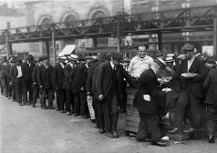
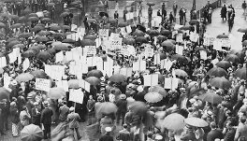
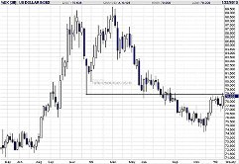
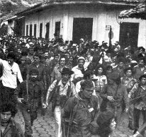
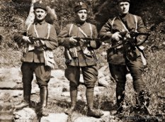
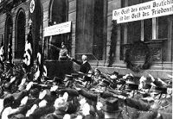
The main trends of social development of the Europe countries in the interwar years

Slide 3
The main trends of social development of the Europe countries in the interwar years
1. Germany in the interwar period. The establishment of fascism
2. Domestic and foreign policy of England
3. France in the interwar period

Slide 4
Germany in the interwar period. The establishment of fascism
War reparations are payments
intended to cover damage or
injury inflicted during a war.
Военные репарации это платежи предназначенные для покрытия ущерба или вреда, нанесенного во время войны.
The Dawes Plan was an attempt following World War I for the Triple Entente to compromise and collect war reparations debt from Germany
План Дауэса это попытка для Антанты прийти к компромиссу и сбору военных репарационных долгов Германии после Первой мировой войны
By 1924, German capitalism has stabilized
It was promoted by a new reparations Dawes plan
With the help of the American Loan German imperialists not only regained their pre-war positions, but quickly began to overtake its imperialist competitors

Slide 5
Germany in the interwar period. The establishment of fascism
The economic crisis is a sudden decline, decline in output, accompanied by the ruin of many enterprises, rising unemployment, falling wages and the share price.
Экономический кризис это внезапный спад, сокращение производства, сопровождающееся разорением многих предприятий, ростом безработицы, падением заработной платы и курса акций.
From 1924 to 1929 the foreign capital amounted to about 30 billion marks, of which 70% are American loans.
The economic crisis of 1929 that swept the entire capitalist world, collapsed and Germany.
The bourgeois parties saw a way out of the crisis in a new war for the redivision of the world markets and sources of raw materials and capital investment spheres.
German monopolies and Junkers headed for the establishment of the fascist regime

Slide 6
Germany in the interwar period. The establishment of fascism
Fascism is a political movement of the twentieth century, a specific form of government
Фашизм – политическое движение ХХ века, специфическая форма государственного правления
In January 1919, was founded by the fascist National Socialist Party, led by Hitler.
Social base amounted to nationalist artisans, peasants, war veterans, the unemployed
A major support is provided by the reactionary circles of American capital
In 1929, the American Bankers passed 10 million, and in 1931, $ 15 million

Slide 7
Germany in the interwar period. The establishment of fascism
The characteristic features
Nationalism and racism
The rejection of democracy
The desire to create a totalitarian state
The worship of violence

Slide 8
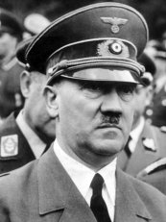
Germany in the interwar period. The establishment of fascism
January 20, 1933 Adolf Hitler became chancellor
The coming to power of the Nazis accelerated training in the new world war
If in 1932 the share of military spending in the budget is 2%, then In 1939, the figure was 60.4%

Slide 9
Germany in the interwar period. The establishment of fascism
Activities of the fascist government
The elimination of the bourgeois-democratic liberties
Providing unlimited powers punitive organs
The abolition of the principle of separation of powers
The prohibition all political parties(except the Nazi Party)
Administrative reform
Creation of the secret police (Gestapo), concentrated camps, anti-Semitism

Slide 10
Answer to the Tests
Whose interests are protected National Socialist German Workers Party?
A) Veterans
B) the reactionary circles of the financial capital
C) workers
D) of the peasantry
E) of the urban poor
How was called plan of economic recovery after World War I of Germany?
A) Plan of Jung
B) 14 points
C) The Dawes Plan
D) New Deal
E) The Marshall Plan
In what year did Adolf Hitler became Reich Chancellor?
А) 1933 В) 1932 С) 1931 D) 1930 Е) 1929

Slide 11
Domestic and foreign policy of England
By 1929, the level of economic development has reached pre-war levels
After the First World War, the Labour Party has become a significant political force in the country
In January 1924, the government was headed by MacDonald
Domestic and foreign policy Labour Party responded of the interests big bourgeoisie
In October 1924 the government led by the Conservatives, led by Baldwin, who represented the interests of the landlords
In 1924, the Labour government restored diplomatic relations with the USSR
In 1927, relations with the USSR were severed

Slide 12
Domestic and foreign policy of England
In 1929, MacDonald formed a new government, which lasted until 1936.
In 1931, the adoption of the Statute of Westminster, which is recognized for the complete independence of the dominions
In 1932, the government moves to introduce protectionist policies and high tariffs on foreign goods
Since 1934, the country's economy on the military effort
The government subsidizes the development of metallurgy, mechanical engineering and other industries
In foreign policy, the Macdonald government was looking for ways and means of directing aggression of Nazi Germany against the Soviet Union
In 1933, in Rome, was signed a pact the consent and cooperation of four powers - Britain, Germany, France and Italy
In 1935 signed a naval agreement with Germany
In 1937, the program was adopted increased military spending by 3 times
In 1939, the English Parliament passed a law on conscription

Slide 13
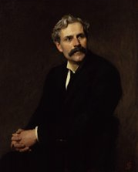
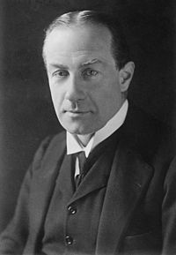
Domestic and foreign policy of England
In 1937, was adopted the program weapons
The economic recovery was not sustainable, leading to the strengthening of fascist tendencies
In 1932 he founded "The British Union of Fascists," led by Mosley
Since 1937, the government was headed by Neville Chamberlain
Ramsay MacDonald
Stanley Baldwin

Slide 14
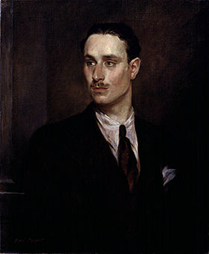
Domestic and foreign policy of England
Oswald Mosley

Slide 15
Answer to the Tests
Why fascism is not widely used in the UK?
A) government pursued liberal reforms
B) Fascism was banned as an ideology
C) the weakness of Nazi ideology
D) the location of the island country
E) does not have a lot of millions of impoverished
Who headed " British Union of Fascists " ?
A) Horthy
B) Peak
C) MacDonald
D) Baldwin
E) Mosley
Which state in 1935 Britain concluded a naval agreement?
A) France
B) U.S.
C) Russia
D) Italy
E) Germany

Slide 16
France in the interwar period
The financial and economic situation in France in 20 years of the twentieth century were severe.
The economic crisis started later than in other countries, in the early 30's.
However, the crisis was prolonged and stretched out before the end of 1935.
The country has increased the influence of the fascist
In 1932, the perfume manufacturer Coty creates a fascist party "French solidarity"
In 1924, established diplomatic relations with the USSR
Foreign Minister Bryant creates a plan "Pan Europe". It is the creation of an anti-Soviet bloc capitalist countries led by France

Slide 17
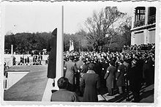
France in the interwar period
In 1933 there was a fascist alliance "Fransisty" and the largest fascist organization «Les Croix de Feu».
At the initiative of the Communist Party in 1935, was created by the Popular Front
The program of the Popular Front is the fight against the threat of fascism and war

Slide 18
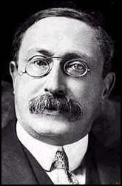
France in the interwar period
The social base of the Popular Front is the petty bourgeoisie
In 1936, the Popular Front headed by Leon Blum led government

Slide 19
France in the interwar period
The activities of the Popular Front government
Prohibition fashistsih organization
The Law of 40 hour work week
Annual paid leave
The increase in pensions and unemployment benefits
The nationalization of the Bank of France and a number of military factories

Slide 20
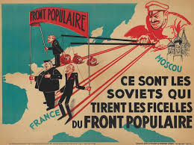
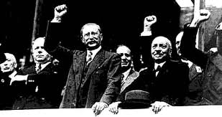
France in the interwar period
In 1937, the country's economy crisis-struck
Under pressure from the reaction of the Popular Front government resigns

Slide 21
France in the interwar period
In 1938, the government was headed by the radical right Daladier
Increased direct and indirect taxes
Lowered taxes on the profits of large industrial and trade enterprises
Devaluation of the franc
Increased payroll taxes, excise taxes on consumer goods, introduced additional working hours
Daladier foreign policy has been reduced to support the Munich Agreement

Slide 22
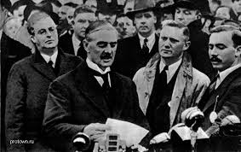
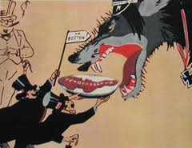
France in the interwar period
The Munich Agreement is an agreement between Britain, Germany, Italy and France on the accession of the Sudetenland of Czechoslovakia (1938)
Мюнхенский сговор это соглашение между Англией, Германией, Италией и Францией о присоединении Судетской области Чехословакии (1938)

Slide 23
Answer to the Tests
As the organization created for fight against threat was called fascism and war?
A) resistance
B) Popular front
C) Komintern
D) free France
E) antikomintern pact
Between which countries was concluded the Munich Agreement?
A) France, the USSR, Italy, Germany
B) United States, Soviet Union, France, Great Britain
C) the United States, Japan, China, the Soviet Union
D) the Soviet Union, Great Britain, Italy, Japan
E) France, Great Britain, Germany, Italy
In what year was established in France People's Front?
А) 1929 г. В) 1933 г. С) 1941 г. D) 1940 г. Е) 1935 г.

Slide 24
Thank you for your attention

